Slide 1
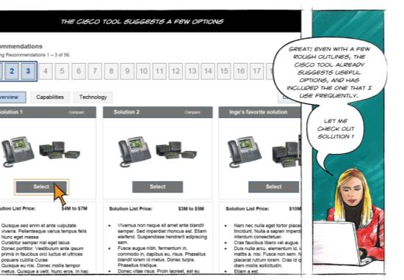
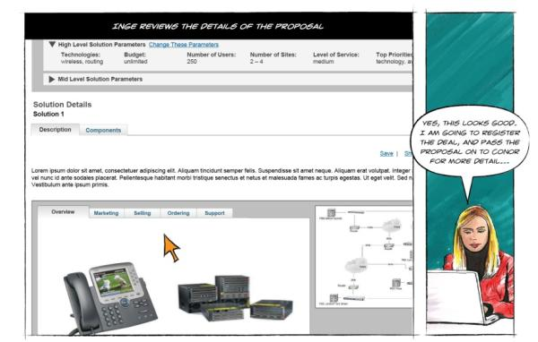
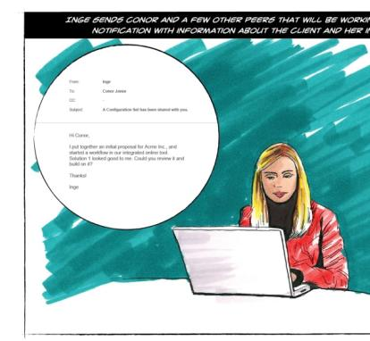
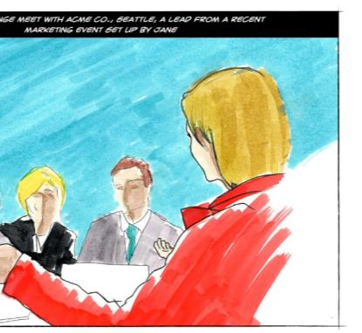
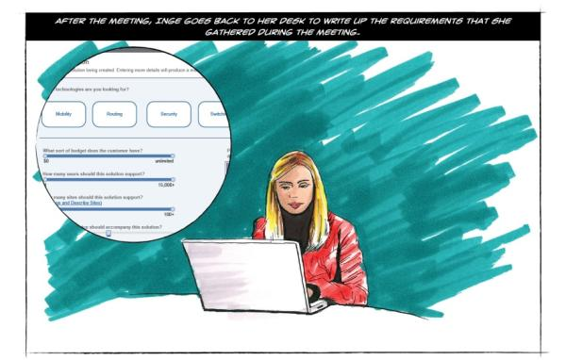
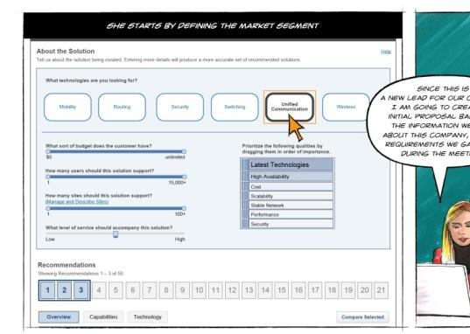

Scenarios
Professor Jon Kolko

Slide 2
Prototyping
Research
Transcription
Utterances
Patterns & Anomalies
Interpretation
Insights
Principles
Value
Promise
Stories
Ethnography
Synthesis
Prototyping
Immersion in the cultural context of a wicked problem
Making meaning through inference and reframing
Hypothesis validation through generative, form-giving activities

Slide 3
Moving Toward Product Requirements
Research
Transcription
Utterances
Patterns & Anomalies
Interpretation
Insights
Principles
Value
Promise
Stories
Our goal:
To craft compelling visions for products and services from key experiential pillars, in order to deliver on the value promise for our users.
Fidelity (level of detail) is increased over time.
Divergent thinking and rapid ideation is required.
Think idealistically. It’s much easier to move concepts back to practicality.
Think systemically. Use customer journey maps to ideate at varying levels of semantic zoom.
Technical and business considerations are incorporated or reconsidered in combination with the value promise for our users.
This process is constructive, not evaluative. “Yes and..”

Slide 4
Crafting Through Narrative Story Telling
Research
Transcription
Utterances
Patterns & Anomalies
Interpretation
Insights
Principles
Value
Promise
Stories
Scenarios
A written story that explains how a person will use a product, system, or service to achieve a goal.
Is a credible, end-to-end articulation of a single instance of use.
Describes the ideal state of the product, system, or service – through the story of a hero use case.
Typically chooses an intercept point present in the “existing state” customer journey map.
Allows us to articulate “the forest and the trees.”
Is the first pass at crafting the concept.
Includes the context of use.

Slide 5
Crafting Through Narrative Story Telling
Research
Transcription
Utterances
Patterns & Anomalies
Interpretation
Insights
Principles
Value
Promise
Stories
Breadth, not Depth
The goal for a design team is rapid ideation: the creation of as many divergent manifestations as possible within the time allowed.
To achieve this goal, we’ll pivot and reframe on how a concept can change over time, between users, between contexts, or across different touch points, all while maintaining focus on the functional and emotional “magic moments.”
Our goal is divergence: breadth.

Slide 6
Crafting Through Narrative Story Telling
Research
Transcription
Utterances
Patterns & Anomalies
Interpretation
Insights
Principles
Value
Promise
Stories
Crafting Scenarios for Product Definition
Scenarios can be used to describe a concept generally or explicitly – where the level of detail in the narrative is increased over time.
During product definition it’s better to focus on the concept more generally: think about “What is it?” and “Why should it exist?” Craft the “Magic moments” and touch points that illustrate the value proposition.
Ignore the explicit interface sequences that are required for someone to “use” the idea – those come later.
Example Magic Moment: A study buddy application that connects a person to a live physics tutor during their “time of need” in preparing for a final.

Slide 7
Example Scenario
Research
Transcription
Utterances
Patterns & Anomalies
Interpretation
Insights
Principles
Value
Promise
Stories
Career Explorer: Scenario
It’s the middle of freshman year and Amy is at her part time job as a sales associate at retailer in the mall. Amy has been relatively good at keeping track of what she needs to do for her classes, but is worried about what major she is going to select – and what job she’s going to get as a result.
Amy downloads the career explorer app by Blackboard because she heard about it from a friend. Amy opens the application and is surprised to find that the app is really light hearted – almost fun (as characters bounce around on the screen).
The app asks her what she is looking for – money, power, or notoriety. She taps “power” and the system gives her some more options. After pressing “find jobs”, she sees a job come into the screen with a tinder-like interaction (“Is this for you? Yes, No, Maybe”).
Amy browses a couple of jobs, tapping “no” each time. She lands on one that fits her and taps “yes”. The system celebrates! It offers her a moment to keep browsing or find courses of study that can get her to this career.

Slide 8
Example Scenario
Research
Transcription
Utterances
Patterns & Anomalies
Interpretation
Insights
Principles
Value
Promise
Stories
Career Explorer: Scenario
It’s the middle of freshman year and Amy is at her part time job as a sales associate at retailer in the mall. Amy has been relatively good at keeping track of what she needs to do for her classes, but is worried about what major she is going to select – and what job she’s going to get as a result.
Amy downloads the career explorer app by Blackboard because she heard about it from a friend. Amy opens the application and is surprised to find that the app is really light hearted – almost fun (as characters bounce around on the screen).
The app asks her what she is looking for – money, power, or notoriety. She taps “power” and the system gives her some more options. After pressing “find jobs”, she sees a job come into the screen with a tinder-like interaction (“Is this for you? Yes, No, Maybe”).
Amy browses a couple of jobs, tapping “no” each time. She lands on one that fits her and taps “yes”. The system celebrates! It offers her a moment to keep browsing or find courses of study that can get her to this career.

Slide 9
Example Scenario
Research
Transcription
Utterances
Patterns & Anomalies
Interpretation
Insights
Principles
Value
Promise
Stories
Career Explorer: Scenario
It’s the middle of freshman year and Amy is at her part time job as a sales associate at retailer in the mall. Amy has been relatively good at keeping track of what she needs to do for her classes, but is worried about what major she is going to select – and what job she’s going to get as a result.
Amy downloads the career explorer app by Blackboard because she heard about it from a friend. Amy opens the application and is surprised to find that the app is really light hearted – almost fun (as characters bounce around on the screen).
The app asks her what she is looking for – money, power, or notoriety. She taps “power” and the system gives her some more options. After pressing “find jobs”, she sees a job come into the screen with a tinder-like interaction (“Is this for you? Yes, No, Maybe”).
Amy browses a couple of jobs, tapping “no” each time. She lands on one that fits her and taps “yes”. The system celebrates! It offers her a moment to keep browsing or find courses of study that can get her to this career.

Slide 10
Example Scenario
Research
Transcription
Utterances
Patterns & Anomalies
Interpretation
Insights
Principles
Value
Promise
Stories
Career Explorer: Scenario
It’s the middle of freshman year and Amy is at her part time job as a sales associate at retailer in the mall. Amy has been relatively good at keeping track of what she needs to do for her classes, but is worried about what major she is going to select – and what job she’s going to get as a result.
Amy downloads the career explorer app by Blackboard because she heard about it from a friend. Amy opens the application and is surprised to find that the app is really light hearted – almost fun (as characters bounce around on the screen).
The app asks her what she is looking for – money, power, or notoriety. She taps “power” and the system gives her some more options. After pressing “find jobs”, she sees a job come into the screen with a tinder-like interaction (“Is this for you? Yes, No, Maybe”).
Amy browses a couple of jobs, tapping “no” each time. She lands on one that fits her and taps “yes”. The system celebrates! It offers her a moment to keep browsing or find courses of study that can get her to this career.

